Slide 1
CCS Apologetics
BIBLICAL APOLOGETICS

Slide 2
Some Brief Definitions
Apologetics is the branch of theology that offers a rational defense/explanation for the truthfulness of the divine origin and authority of Christianity
The Greek, apologia, means to give a defense or an answer
An “apology” is not the same as “I’m sorry”
1 Peter 3:15 says, “But, in your hearts honor Christ the Lord as holy, always being prepared to make a defense to anyone who asks you for the hope that is in you; yet do it with gentleness and respect.”

Slide 3
defense

Slide 4
I Peter 3:15
but in your hearts honor Christ the Lord as holy, always being prepared to make a defense to anyone who asks you for a reason for the hope that is in you; yet do it with gentleness and respect,

Slide 5
So, how has this looked . . .
Think Back . . .any stories?

Slide 6
What we do
1 Peter 3:15

Slide 7
I Peter 3:15
but in your hearts honor Christ the Lord as holy, always being prepared to make a defense to anyone who asks you for a reason for the hope that is in you; yet do it with gentleness and respect,

Slide 8
Why we do What we do
2 Corinthians 5:11-15

Slide 9
11 Therefore, knowing the fear of the Lord, we persuade others. But what we are is known to God, and I hope it is known also to your conscience. . . 14 For the love of Christ controls us, because we have concluded this: that one has died for all, therefore all have died; 15 and he died for all, that those who live might no longer live for themselves but for him who for their sake died and was raised. 2 Cor. 5:11, 14-15

Slide 10
What keeps us doing What we do
Matthew 22:34-40

Slide 11
34 But when the Pharisees heard that he had silenced the Sadducees, they gathered together. 35 And one of them, a lawyer, asked him a question to test him. 36 “Teacher, which is the great commandment in the Law?” 37 And he said to him, “You shall love the Lord your God with all your heart and with all your soul and with all your mind. 38 This is the great and first commandment. 39 And a second is like it: You shall love your neighbor as yourself. 40 On these two commandments depend all the Law and the Prophets.” (Matt. 22:34-40)

Slide 12
LOVE GOD LOVE PEOPLE
The Point . . .

Slide 13
In Review . . .
Apologetics provides answers to questions
Apologetics provides responses to criticisms
The Early Church developed Creeds and Confessions to respond and define
To respond, we must engage and we must think
To respond properly, we must have the correct foundation and the correct motivation

Slide 14
Review . . .
We are compelled by Christ (2 Cor. 5:14)
Because we know the fear of the Lord, we persuade men (2 Cor. 5:11)
We are always ready for anyone (1 Peter 3:15)
We are to answer about our hope (1 Peter 3:15)
We are to honor the Lord and treat people with gentleness and humility (1 Peter 3:15)

Slide 15
Review . . .
This is difficult, because the foundation that we have (Christ and the Gospel) and the motivation that we have (Love God and love people) are not accepted by our world.
Our world has escaped from reason by seeking answers in either humanism or relativism.
In the discussion on Faith vs. Reason, it is not either/or, it is Both/And

Slide 16
Today . . .
. . . Are you willing to fail & will you look and love long enough?

Slide 17
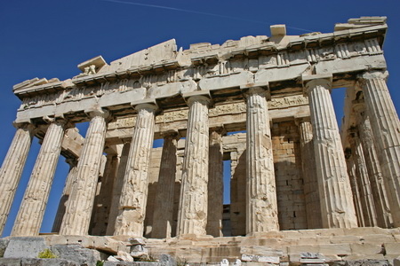
Acts 2, 17, 22, 26

Slide 18
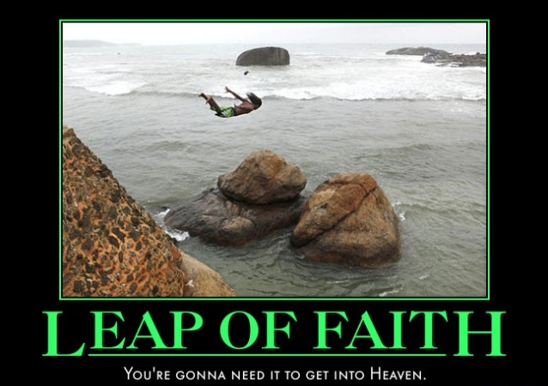
How do these passages work with Kierkegaard’s Blind Leap of Faith

Slide 19
CCS Apologetics
BIBLICAL APOLOGETICS

